Slide 1
Decision Making and Analytics
Analytics
Descriptive Analytics
Predictive Analytics
Prescriptive Analytics

Slide 2
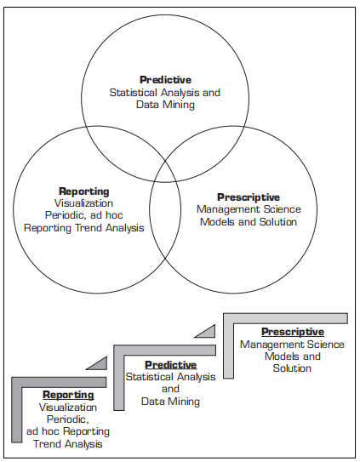
Decision Making and Analytics

Slide 3
Data Mining Concepts and Applications

Slide 4
Data in Data Mining
DM with different data types?
- Other data types?

Slide 5
What Does DM Do? How Does it Work?
DM extracts patterns from data
Pattern?
A mathematical (numeric and/or symbolic) relationship among data items
Types of patterns
Association
Prediction
Cluster (segmentation)
Sequential (or time series) relationships

Slide 6
A Taxonomy for Data Mining Tasks

Slide 7
Cluster Analysis for Data Mining -k-Means Clustering Algorithm

Slide 8
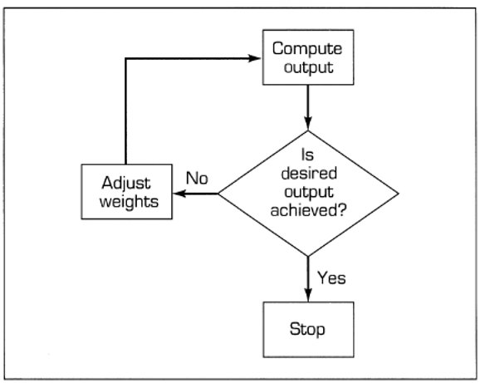
Learning in ANN

Slide 9
Learning in ANN
How a network learns
Learning rate
Momentum
Backpropagation
Procedure for a learning algorithm

Slide 10
Developing Neural Network–Based Systems
Data collection and preparation
Selection of network structure
Topology
Data collection and preparation
Selection of network structure
Learning algorithm selection
Network training
Testing (Black-box testing,Implementation of an ANN)
Hopfield networks
Self-organizing networks
Applications of ANN

